Slide 1
Dinghy
Mattias, Niklas, David, Fredrik, Jesper, Alexander, Björn

Slide 2
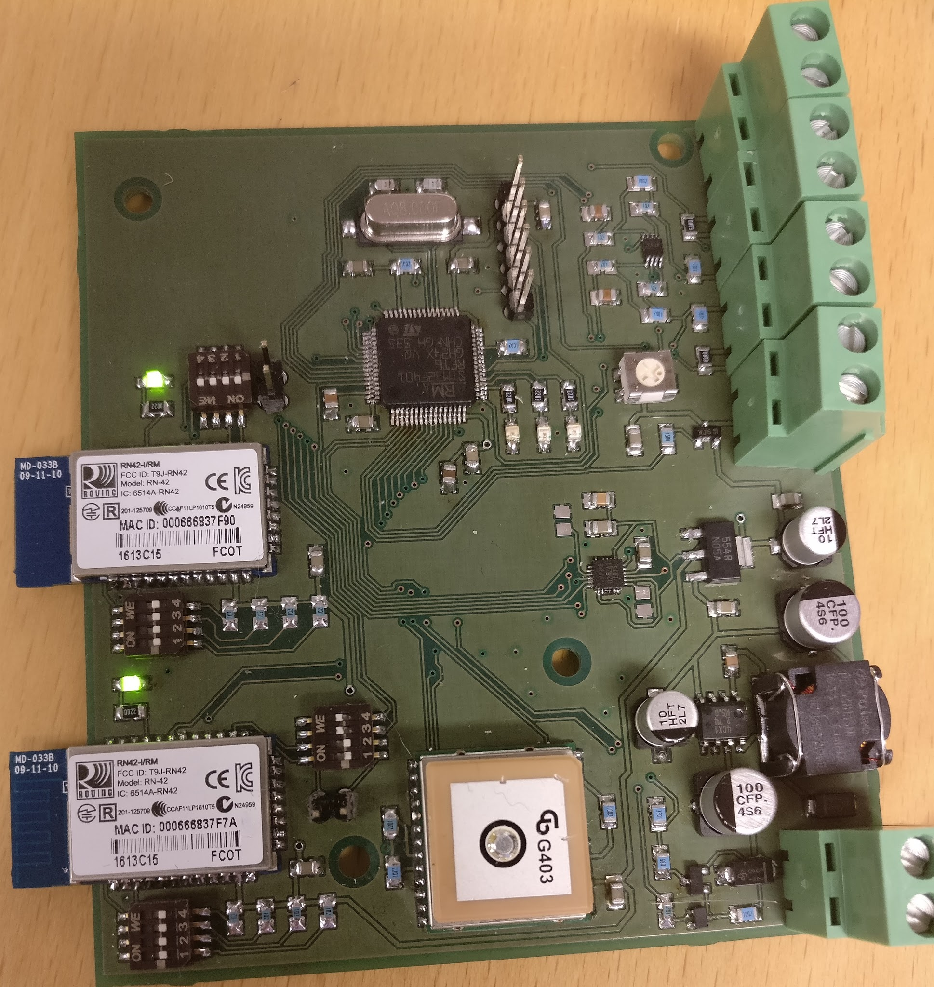

Slide 3
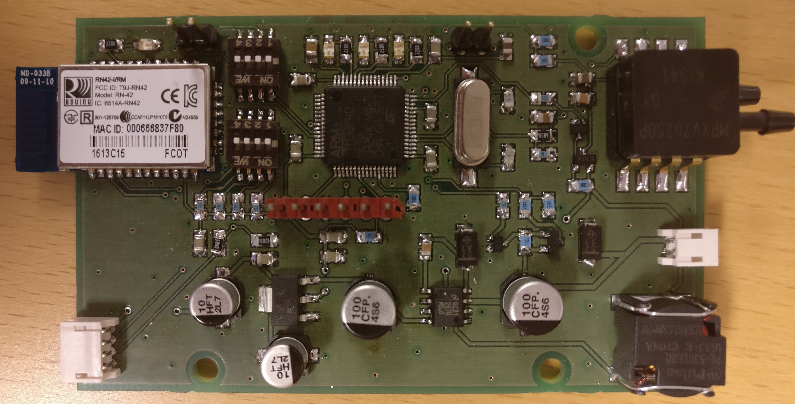

Slide 4
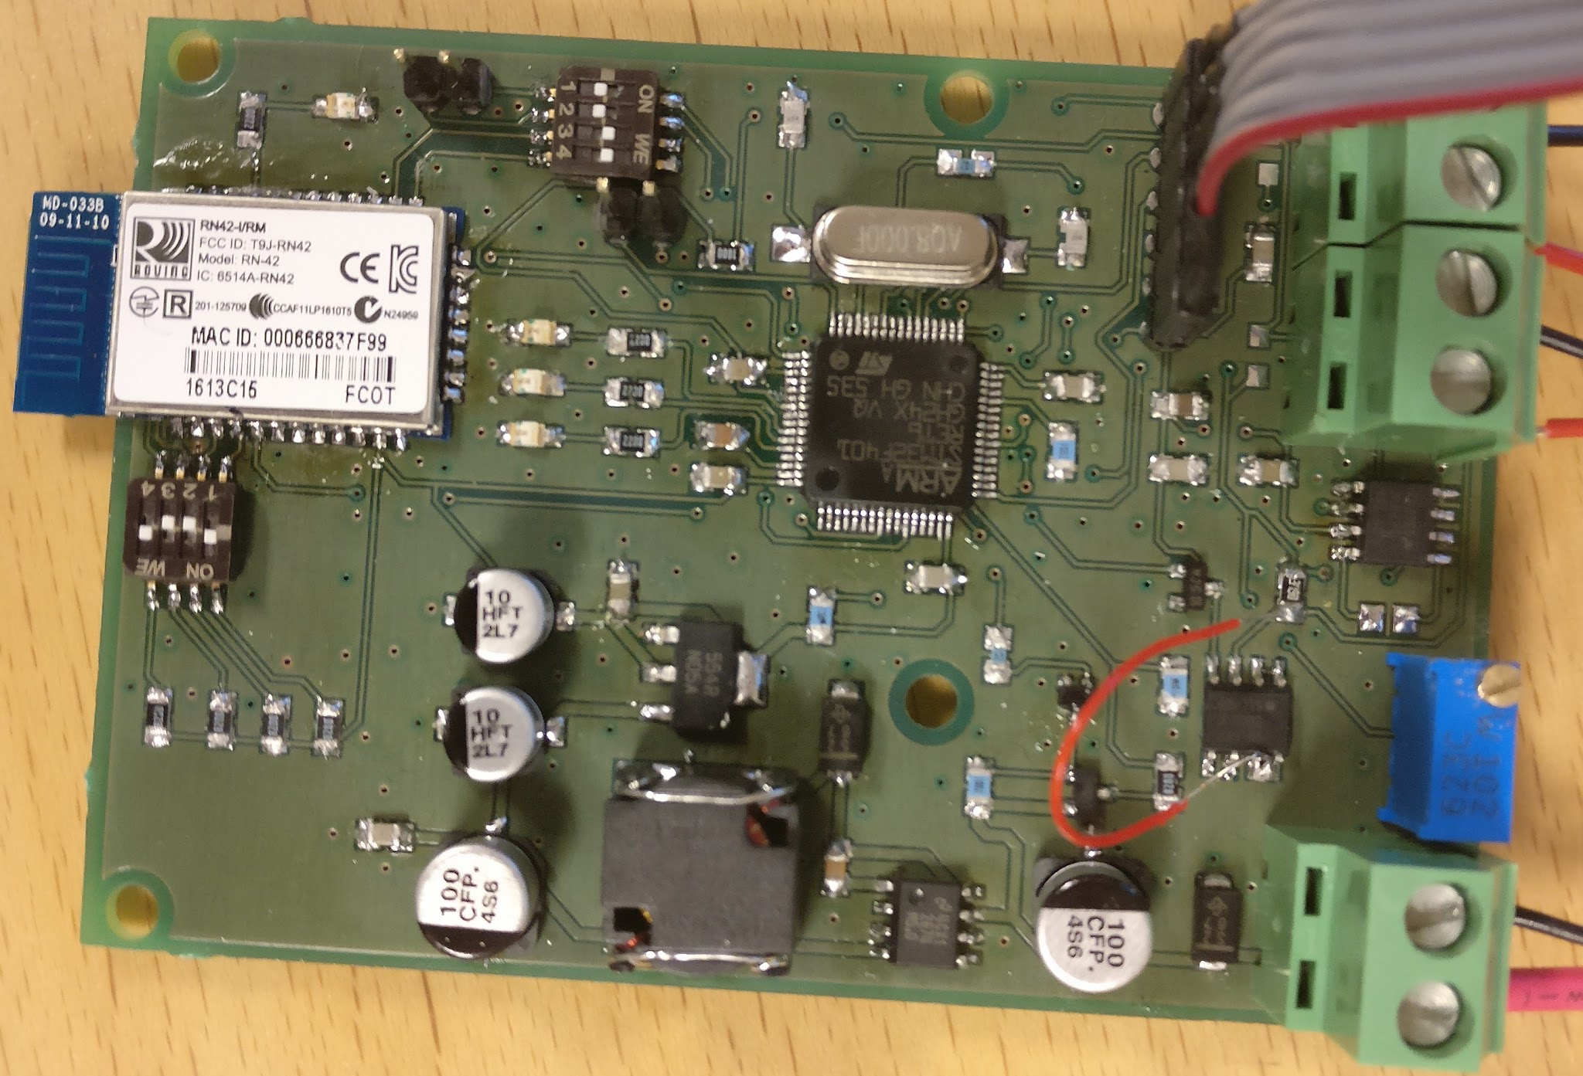

Slide 5
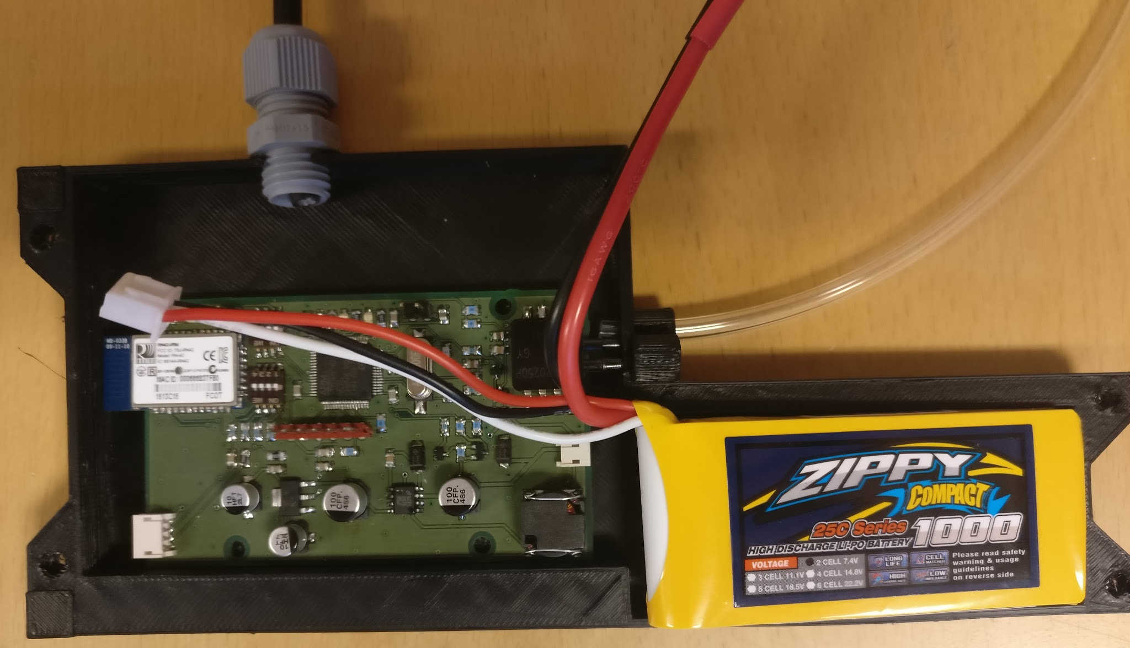

Slide 6
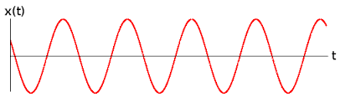
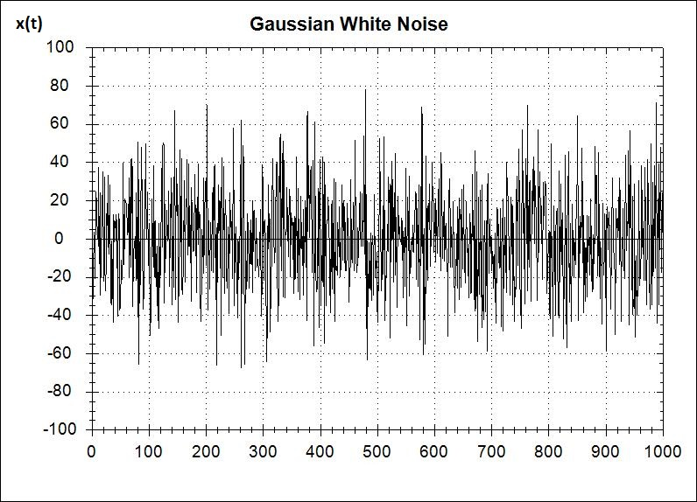
Sensors and data
Requirement
High accuracy positional data
Low budget sensor tend to be noisy
Data isn't representative of actual recorded situation
Data may be unusable and thus analysis is hard

Slide 7
Extended Kalman Filter
EKF
Takes series of input data with uncertainties
Outputs in most cases better data with removed uncertainties
Sensor fusion
Combines sensors
Outputs data that is better than it would be if there was only one sensor used

Slide 8
EKF
A EKF was tested in matlab with simulated horizontal motion
A lot of tuning and tweaking made this filter decent
Estimate in position (x-axis)
2.5 meter variance
Reduced to 0.79m
Error reduced by 68%
Sensor fusion between
GPS
Accelerometer

Slide 9
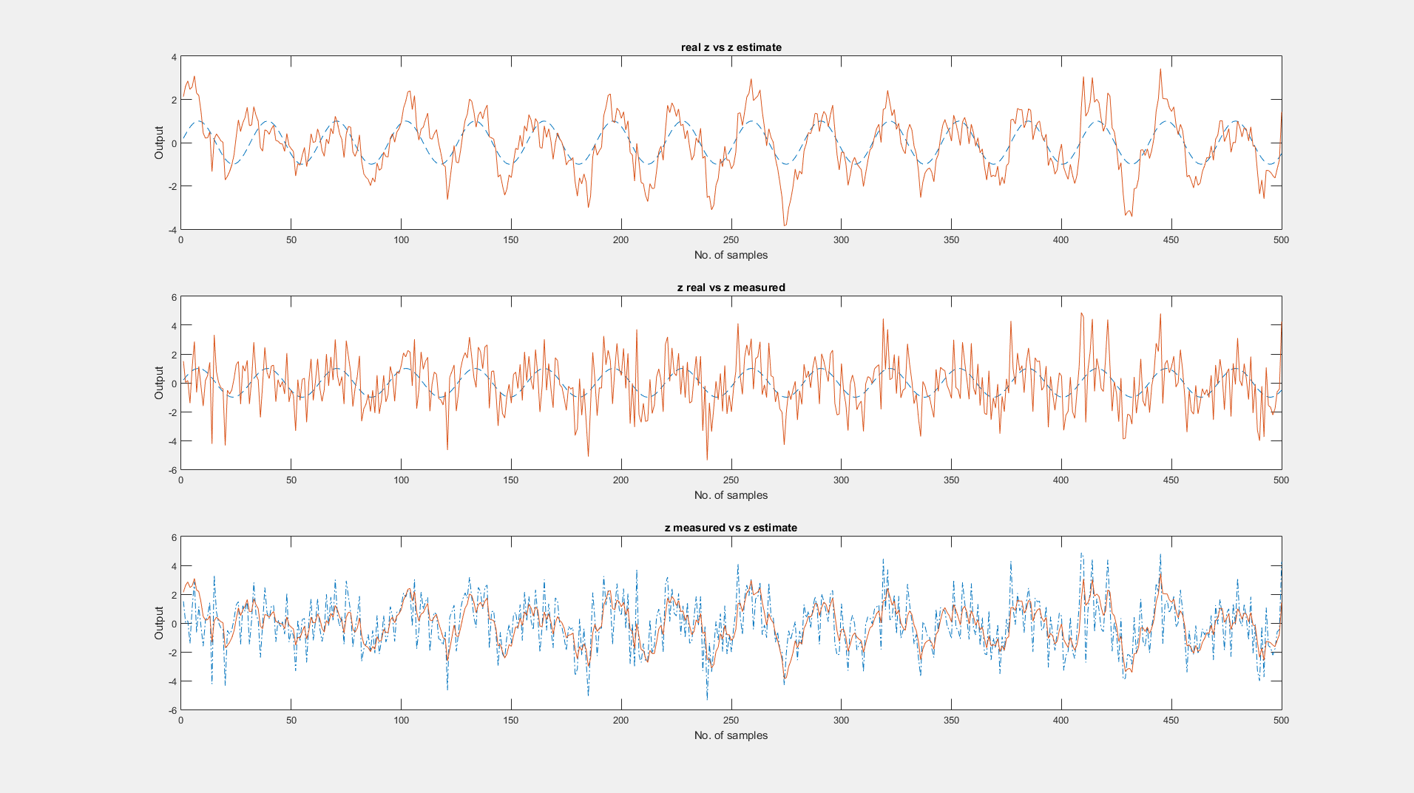

Slide 10
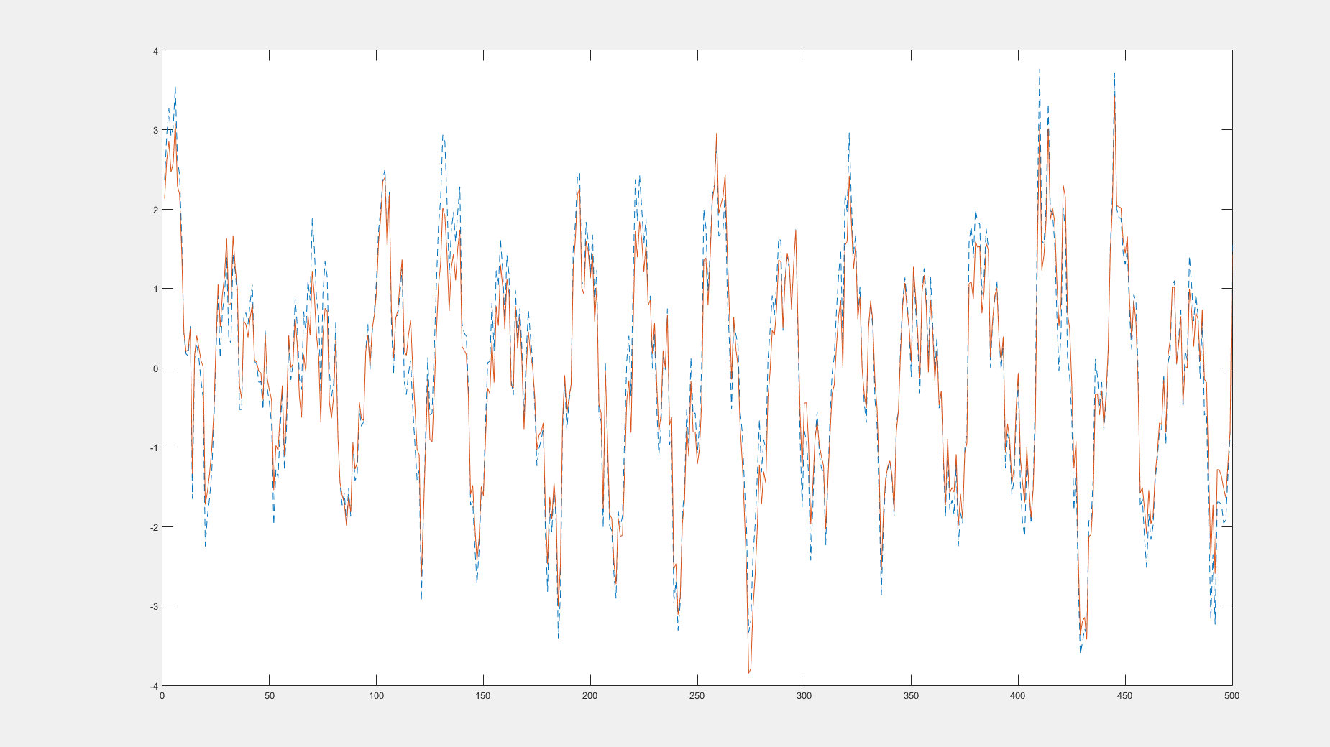
TODO side by side comparison

Slide 11
The Last Slide about the EKF
What is the graphical difference between no sensor fusion and sensor fusion?
Might not seem so much
Error difference between 0.79m and 0.98m

Slide 13
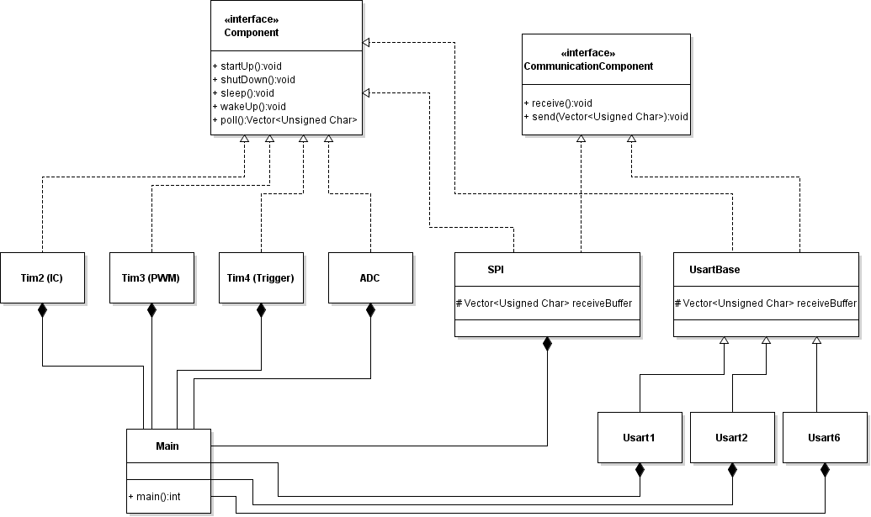
Software - embedded
ADC now working!
Multichannel achieved with DMA implementation
Creating protocols for different BT modules
Established connection between two modules
Converting manual commands into separate protocols
Packed all data into single vector for polling
IMU
Still working on it...

Slide 14
Bluetooth Demo

Slide 15

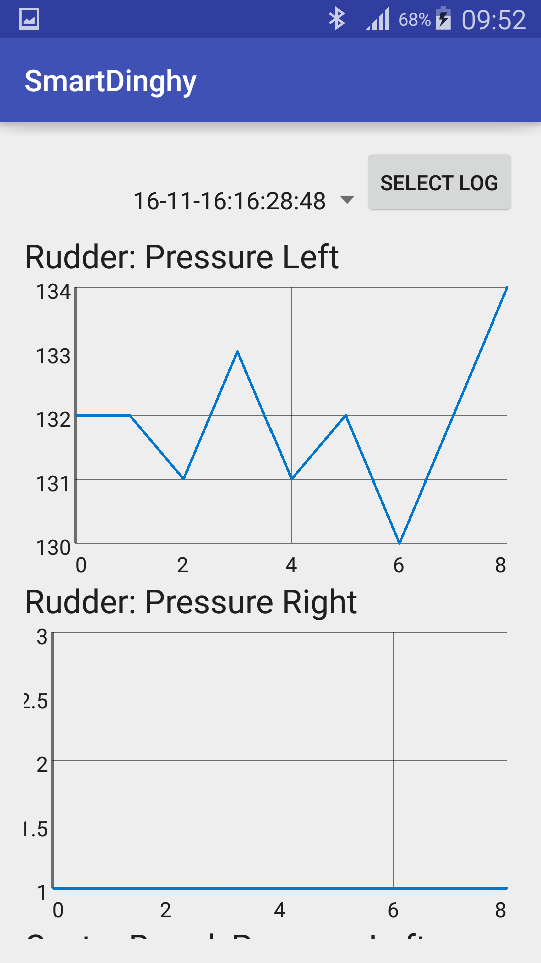
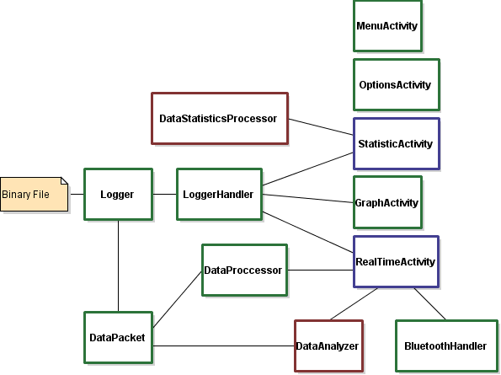
Android

